Slide 1
ORGAN AND TRANSPLANTATION USING FULL STACK DEVELOPMENT

Slide 2

Organ Donation and Transplantation
Presented By
BUSETTI SIVAIAH
(21121F0016 )
Under Guidance Of
Dr. M. Lavanya
Associate Professor and HOD,
MCA Department .
DEPARTMENT OF MCA
SREE VIDYANIKETHAN ENGINEERING COLLEGE
(Autonomous)
Sree Sainath Nagar, A. Rangampet – 517 102. Chittoor (Dist)

Slide 3
ABSTRACT:
Organ donation is defined as giving an organ or part of an organ to be transplanted into another person. Organ transplantation is the only option to save lives in patients affected by terminal organ failures and improve their quality of life. However, there is a disparity exists between the supply and demand of donated organs, leads to a loss of many lives. The number of organ transplantation have gradually increased in the last two decades and provide excellent results in children and young adults, and are challenging by the growing proportion of elderly transplant patients with co morbidity. The results of organ transplantation continue to improve, as a consequence of the innovations and the improvements in peri-operative management. This chapter describes organ donation and transplantation and its trends and challenges.

Slide 4
PROPOSED SYSTEM:
In the proposed system facilitating the people to make and donate their organs, donate money to the organ transplantation process and also have an option to register for organ needed people.
ADVANTAGES OF PROPOSED SYSTEM:
1) In this system have basic information on organ donation and importance of organ donation.
2)It provide option to resister as a organ recipient.

Slide 5
SYSTEM ENVIRONMENT:
HARDWARE REQUIREMENTS:
System : Intel Core i3.
Hard Disk : 256 GB.
Ram : 4 GB.
SOFTWARE REQUIREMENTS:
Operating system : Windows 10.
IDE & Tools : Eclipse.
Database : MYSQL
API Tool : REST API

Slide 6
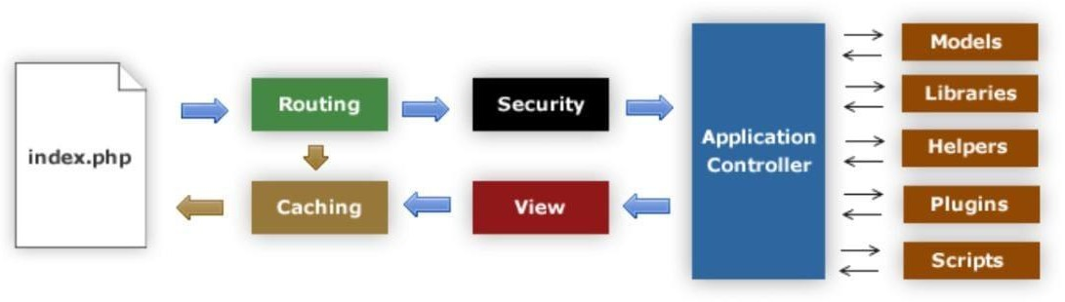
SYSTEM ARCHITECTURE:
Figure: Architecture of CodeIgniter

Slide 7
SYSTEM DESIGN
UML DIAGRAMS :
Stands for Unified Modelling Language. UML is a standardized general-purpose modelling language in the field of object-oriented software engineering. The standard is managed, and was created by, the Object Management Group. The goal is for UML to become a common language for creating models of object-oriented computer software. In its current form UML has two major components: a Meta-model and a notation. In the future, some form of method or process may also be added to; or associated with, UML. The Unified Modelling Language is a standard language for specifying, Visualization, Constructing and documenting the artifacts of software systems, as well as for business modelling and other non-software systems. The UML represents a collection of best engineering practices that have proven successful in the modelling of large and complex systems. The UML is a very important part of developing objects-oriented software and the software development process. The UML uses mostly graphical notations to express the design of software projects.

Slide 8
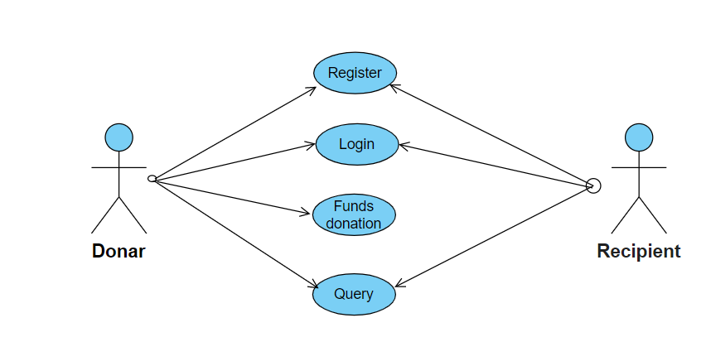
USE CASE DIAGRAM:

Slide 9
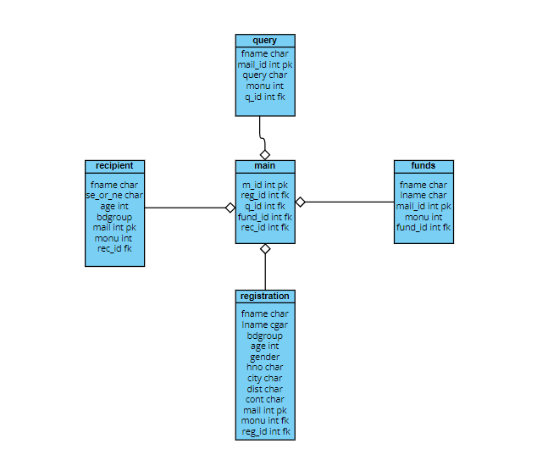
CLASS DIAGRAM:

Slide 10
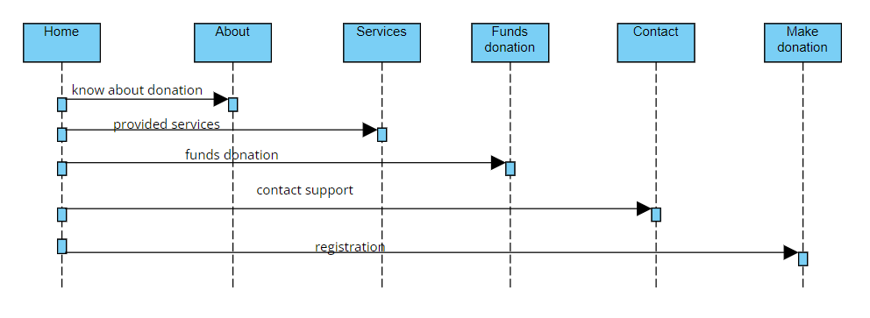
SEQUENCE DIAGRAM:

Slide 11
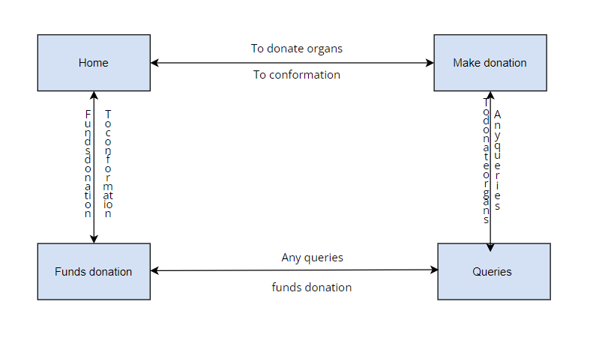
COLLABORATION DIAGRAM:

Slide 12
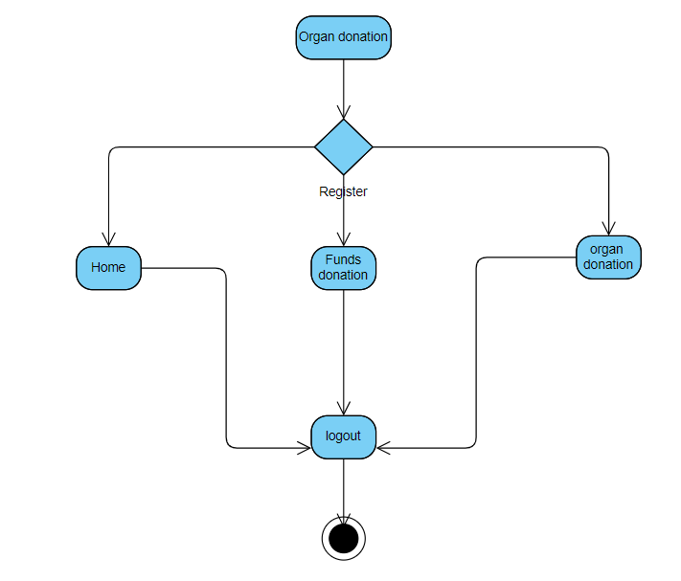
ACTIVITY DIAGRAM:

Slide 13
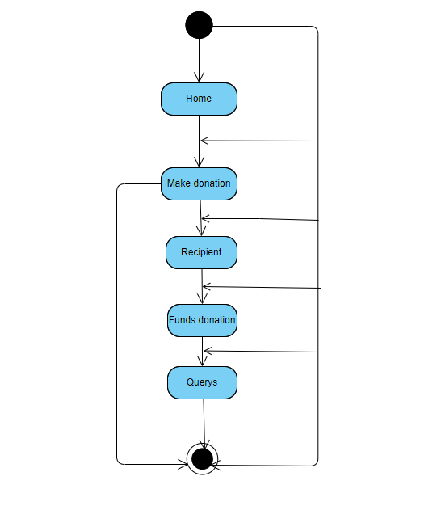
STATE CHART DIAGRAM:

Slide 14
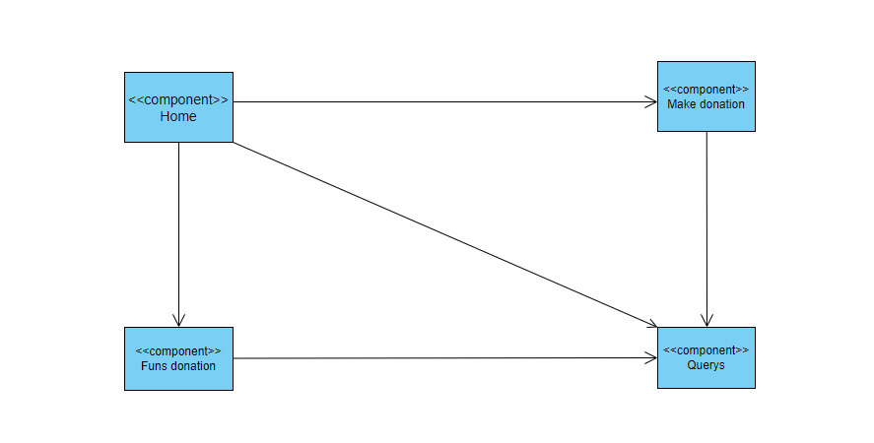
COMPONENT DIAGRAM:

Slide 15
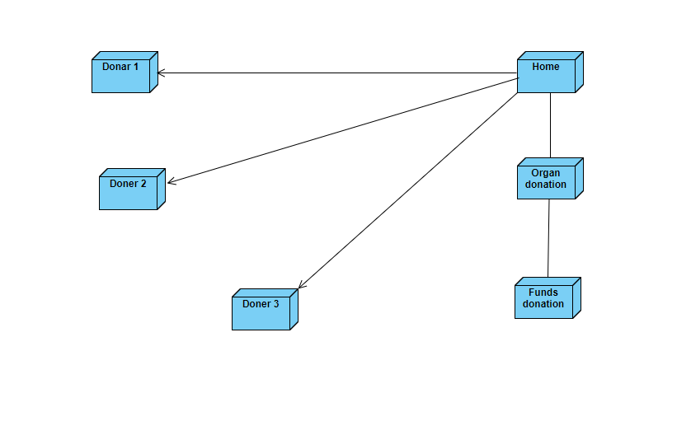
DEPLOYMENT DIAGRAM:

Slide 16
IMPLEMENTATION
Description of technology:
CodeIgniter
CodeIgniter is an Application Development Framework - a toolkit - for people who build web sites using PHP. Its goal is to enable you to develop projects much faster than you could if you were writing code from scratch, by providing a rich set of libraries for commonly needed tasks, as well as a simple interface and logical structure to access these libraries. CodeIgniter lets you creatively focus on your project by minimizing the amount of code needed for a given task.

Slide 17
PHP
PHP is an open-source, interpreted, and object-oriented scripting language that can be executed at the server-side. PHP is well suited for web development. Therefore, it is used to develop web applications (an application that executes on the server and generates the dynamic page.).
MYSQL
MySQL is a relational database management system based on the Structured Query Language, which is the popular language for accessing and managing the records in the database. MySQL is open-source and free software under the GNU license. It is supported by Oracle Company.

Slide 18
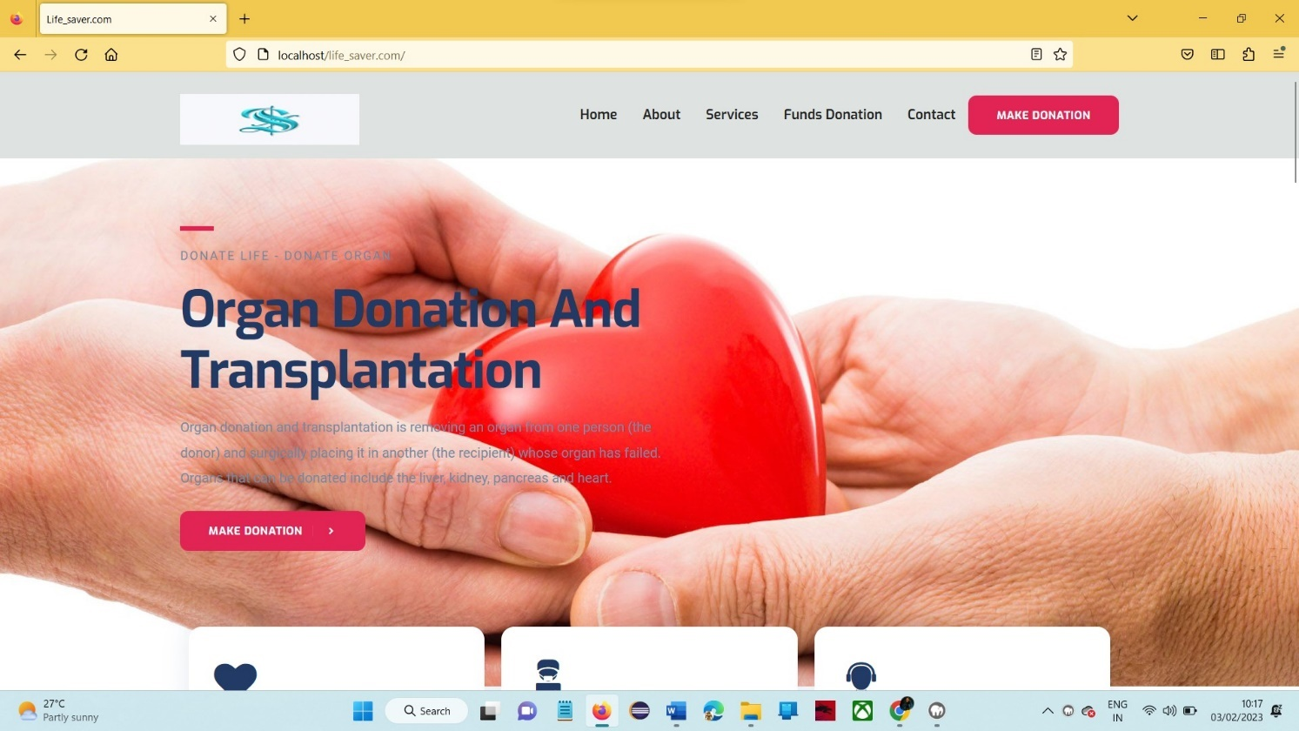
Home Page:

Slide 19
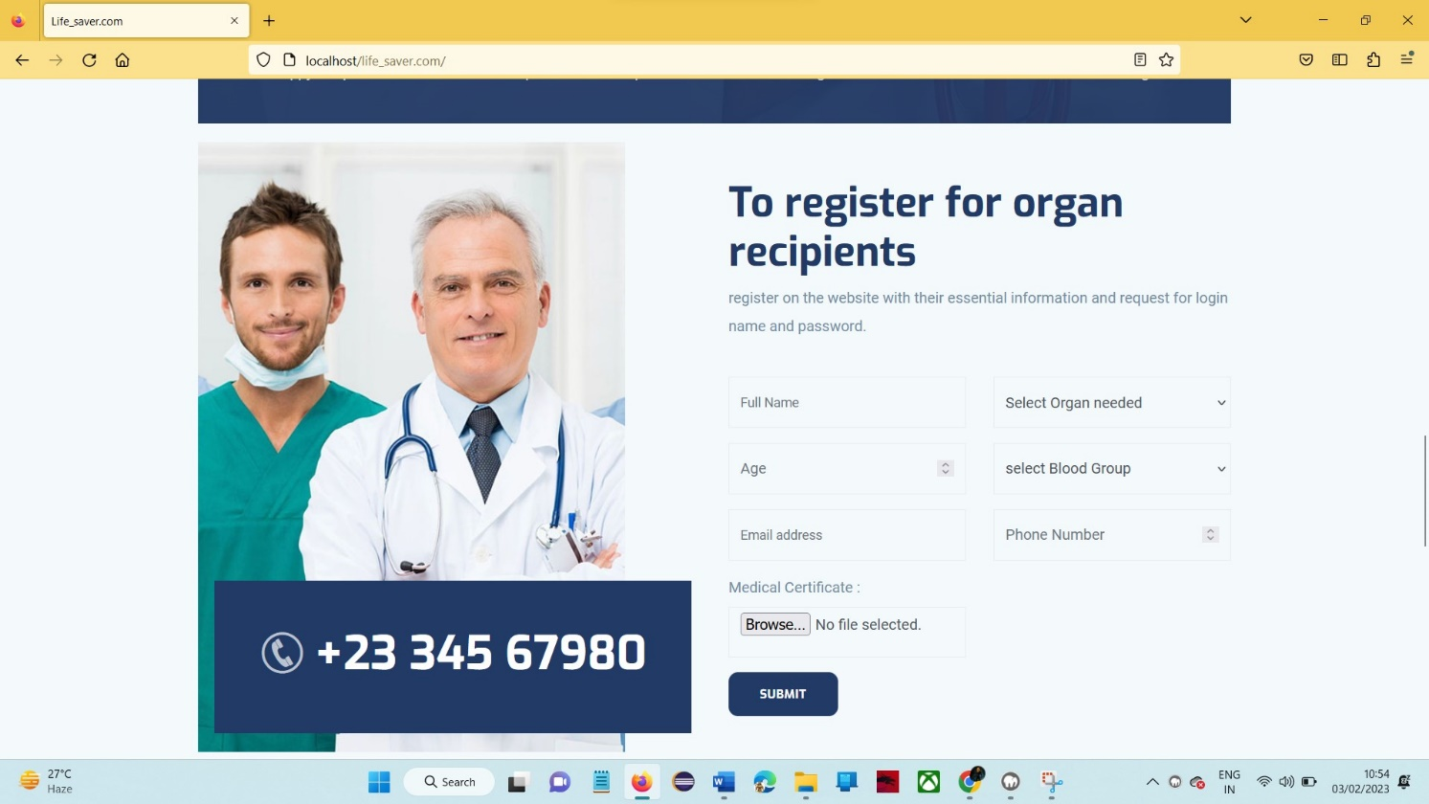
Recipient Register page:

Slide 20
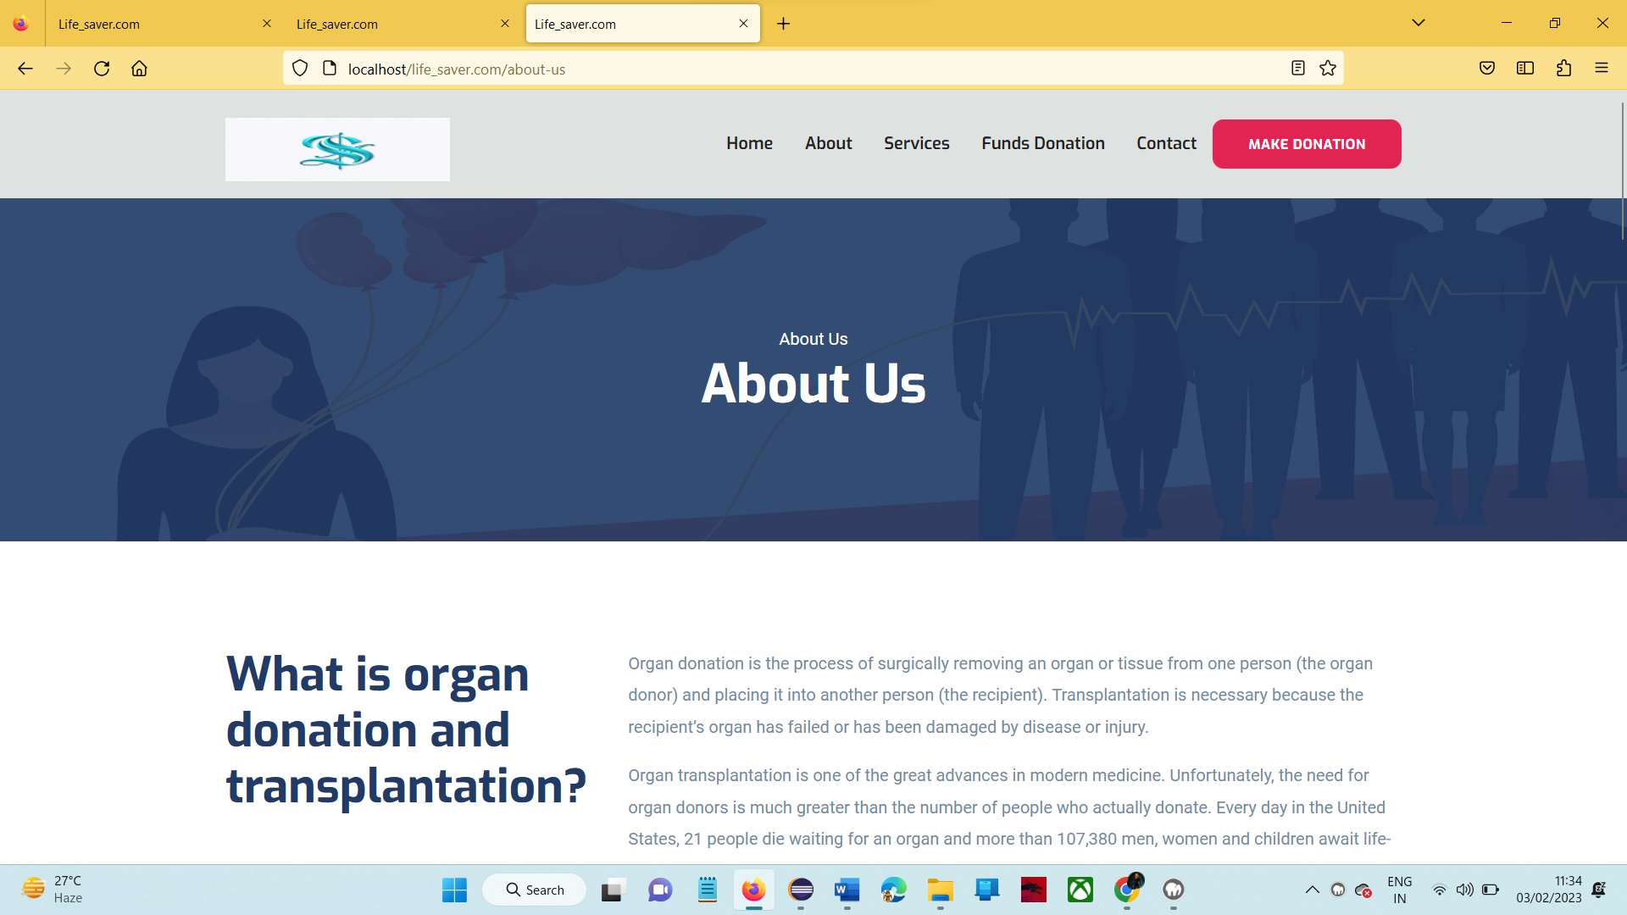
About us page:

Slide 21
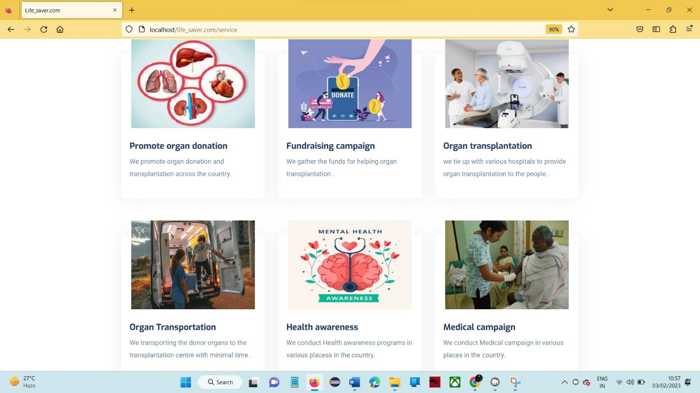
Services:

Slide 22
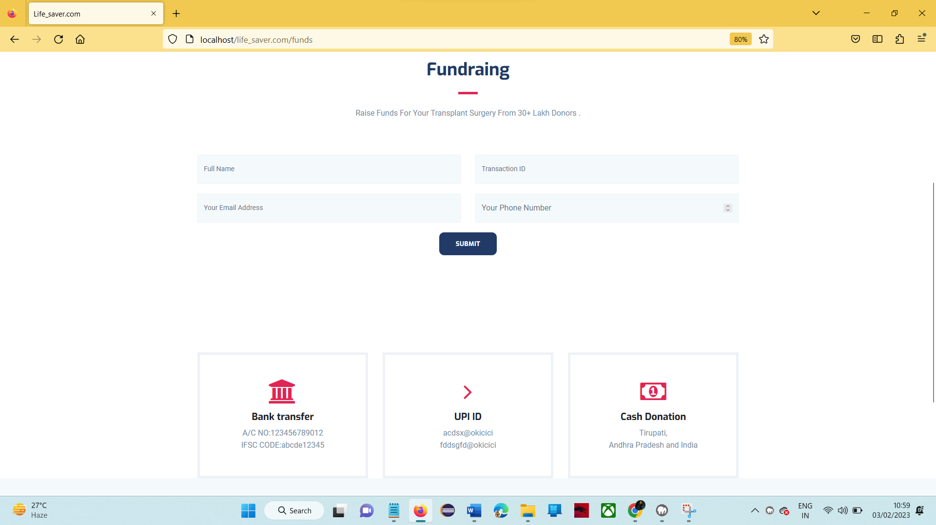
Funds Donation page:

Slide 23
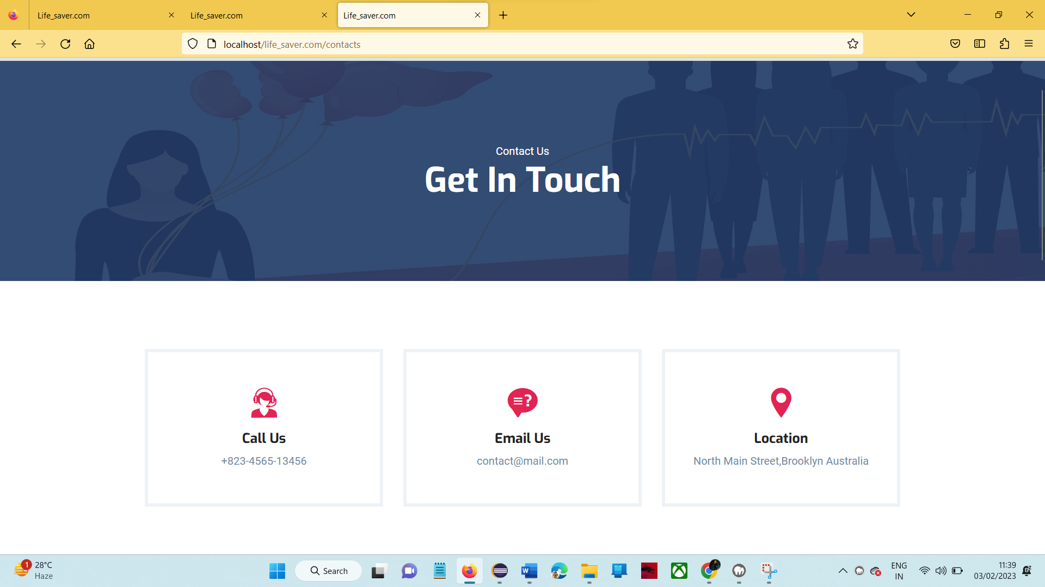
Contact page:

Slide 24
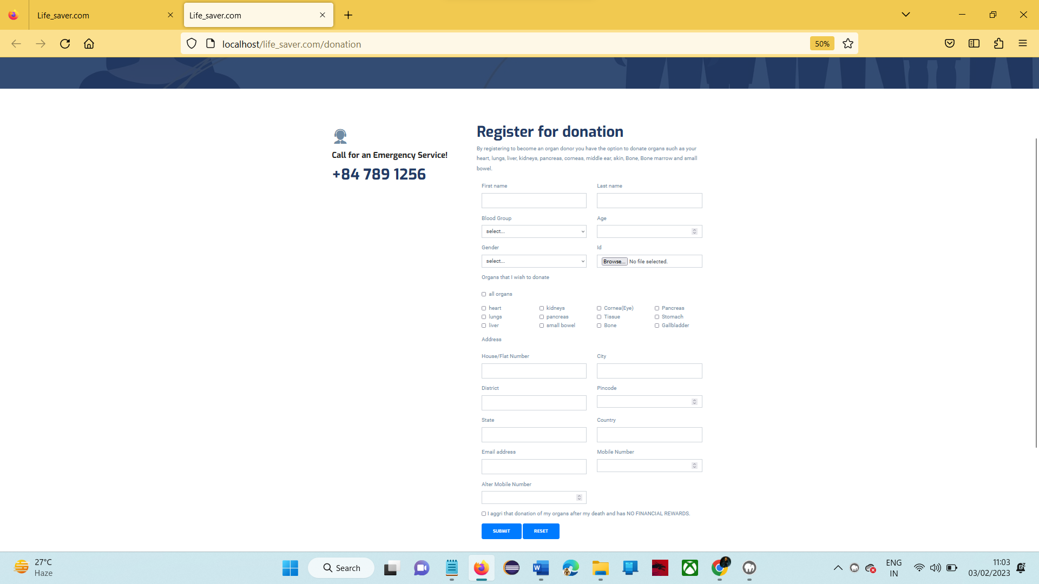
Make donation page:

Slide 25
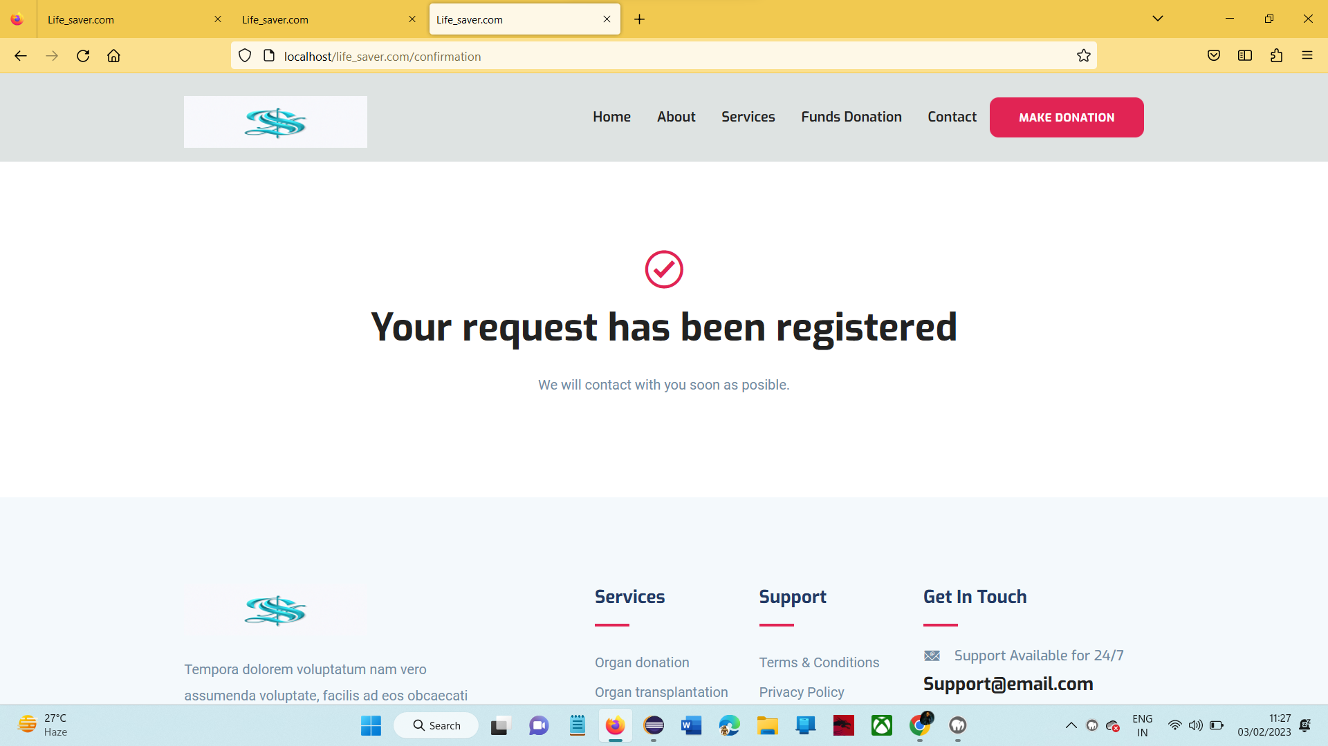
Conformation page:

Slide 26
CONCLUSION:
The Organ Donation and Transplantation System is one of the most fantastic systems for the people who want to become an Organ doner and also who needed organs. this system act as bridge between Organ doner and Organ recipient. This system is also provided option to donate funds to organ transplantation and solve any query on organ donation.

Slide 27
BIBLOGRAPHY:
[1].Learning PHP, MySQL, JavaScript, and CSS: A Step-by-Step Guide to Creating Dynamic Websites – by Robin Nixon
[2]. Programming PHP – by Kevin Tatroe, Peter MacIntyre & Rasmus Lerdorf “Foreword By: Michael Bourque”
[3]. PHP & MySQL Web Development – by Luke Welling & Laura Thompson
[4]. PHP & MySQL: The Missing Manual – by Brett McLaughlin
[5]. Learn PHP & MySQL – Zero to Hero Programming Crash Course – by Paul Madoff
[6]. https://www.codeigniter.com/user_guide/intro/index.html
[7]. https://developer.wordpress.org/coding-standards/inline-documentation-standards/php/

Slide 28


